Slide 1
Information and Organizations
IST 301
Week 12 : Art of Data Visualization

Slide 2
Schedule : We are here
Week | Date | Lecture Topic | Presentations | Assignments | Points | Due Date
1 | 11-Jan | Introductions, course overview, guidelines and expectations |  | Assignment #1 Handout
2 | 18-Jan | MLK Day - No Class |  | Assignment #1 Submission | 50 | 1/22/16 5.00 PM
3 | 25-Jan | Organization, Structure and Functions |  | Assignment #2 Handout
4 | 1-Feb | Field Study + Research Week (No Lecture) |  | Assignment #2 Submission | 50 | 2/05/16 5.00 PM
5 | 8-Feb | Information and Systems | Assignment #2 Presentations | Assignment #3 Handout
6 | 15-Feb | Information System
7 | 22-Feb | Internet of Things – Guest Lecture |  | Assignment #3 Submission | 50 | 2/26/16 5.00 PM
8 | 29-Feb | Data and Analytics (How information is build and used?) | Assignment #3 Presentation | Assignment #4 Handout
9 | 7-Mar | Spring Break- No Class
10 | 14-Mar | Project Work and Quiz Preparation / No Lecture
11 | 21-Mar | No Quiz |  | Assignment #4 Submission | 50 | 3/25/16 5.00 PM
12 | 28-Mar | Data Preparation and Visualization | Assignment #4 Presentation | Assignment #5 Handout
13 | 4-Apr | Big Data and Data Science
14 | 11-Apr | Cloud Computing
15 | 18-Apr | Field Study + Research Week (No Lecture) |  | Quiz | 100 | 4/18/16 5-9 PM
16 | 25-Apr | Course Review + Wrap Up | Assignment #5 Presentation |  | 100
17 | 2-May | No Finals Quiz
 |  | Class Partipication |  |  | 100
 |  |  |  |  | 500

Slide 3


Slide 4
Tapping into the Power of Visual Perception
You don't need to be a graphic artist to design an attractive data visual, but you do need to understand a few basic principles about visual perception.
Vision is by far our most powerful sense. Seeing and thinking are intimately connected.
To display data effectively, we must understand a bit about visual perception, what works, what doesn't, and why.

Slide 5

Thinking with the eyes
Do you see an animal in this picture?

Slide 6

In truth, we don't see with our eyes; we see with our brains. Our eyes are the sensory mechanisms through which light enters and is translated by neurons into electrical impulses that are passed on to and around in our brains.

Slide 7
Pre-attentive and Attentive Processing
Pre-attentive processing, the early stage of visual perception that rapidly occurs below the level of consciousness, is tuned to detect a specific set of visual attributes.
Attentive processing is sequential, and therefore much slower.
The difference is easy to demonstrate:

Slide 8

Attentive Processing
How many fives are in this list?
Note the slow speed at which we process visual stimuli that lack pre-attentive attributes.
The process took you a while because it involved attentive processing. The list of numbers did not exhibit any pre-attentive attributes that you could use to distinguish the fives from the other numbers.
Same exercise again: How many fives are in this list (next slide)?

Slide 9
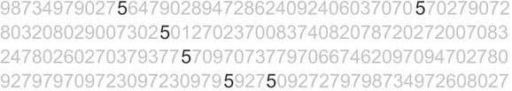

Pre-attentive Processing
Note the fast speed at which we process visual stimuli that exhibit pre-attentive attributes.
Here is one basic but critical difference between a mind numbing excel spreadsheets and visually formatted report or a dashboard

Slide 10



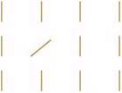

Some Pre-attentive Attributes
Category | Attribute | Illustration
Color | Hue
 | Intensity
Position | 2-D location
Form | Orientation
 | Line length

Slide 11




Some Preattentive Attributes
Category | Attribute | Illustration
Form | Line width
 | Size
 | Shape
 | Enclosure
Motion | Flicker | A visual attribute of an object, such as color, continuously changes back and forth between two values, or the entire object it-self repeatedly appears and then disappears.

Slide 12



Attributes of Color
Context affects our perception of color intensity.
The small square is actually the exact same shade of gray everywhere it appears.
Context also affects our perception of hue.
The word "Text" is exactly the same hue in both boxes.

Slide 13

Using Vivid and Subtle Colors Appropriately
Examples of two color palettes: one for standard use and one for emphasis.

Slide 14
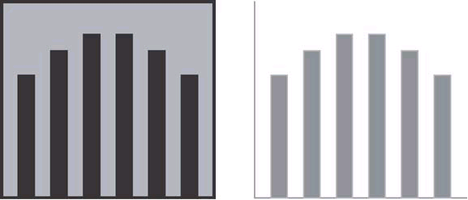
Gestalt Principles of Visual Perception
The Principle of Closure
The Gestalt principle of closure also explains why only two axes, rather than full enclosure, are required on a graph to define the space in which the data appears.

Slide 15

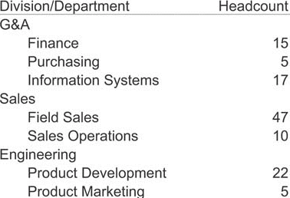
Gestalt Principles of Visual Perception
The Principle of Continuity
We perceive objects as belonging together, as part of a single whole, if they are aligned with one another or appear to form a continuation of one another.
The Gestalt principle of continuity explains why we see this as a single wavy line.
Things that are aligned with one another appear to belong to the same group.

Slide 16
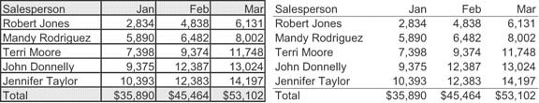
Key Goals in the Visual Design Process
Reduce the Non-Data Pixels
Eliminate all unnecessary non-data pixels.
You should eliminate graphics that provide nothing but decoration.
Grid lines in tables can make simple displays difficult to look at.

Slide 17

Designing for Usability
Choose the Right Text
You want a font that can be read the fastest with the least amount of strain on the eyes.
Find one that works and stick with it throughout the visualization. You can use a different font for headings to help them stand out if you wish, but that's the practical limit.
Examples of some fonts that are easy to ready and some that are not.

Slide 18
Common Mistakes in Data Visualization

Slide 19
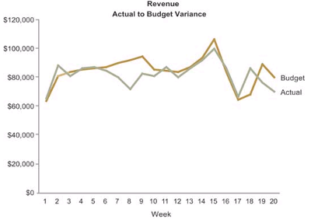
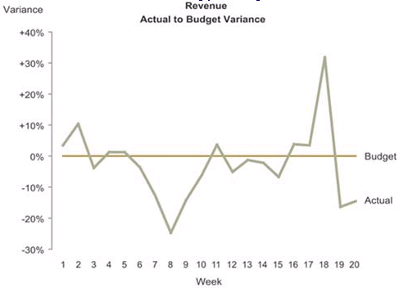
Choosing a Deficient Measure
For a measure to be meaningful, we must know what is being measured and the units in which the measure is being expressed. (If we only need to know to what degree actual revenue differs from budgeted revenue, it would be more direct to simply express the variance rather than displaying the actual and budgeted revenue amounts and leaving it to the viewer to calculate the difference)

Slide 20
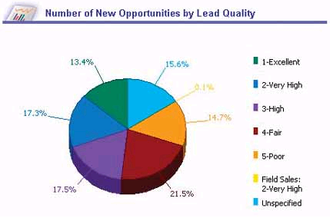
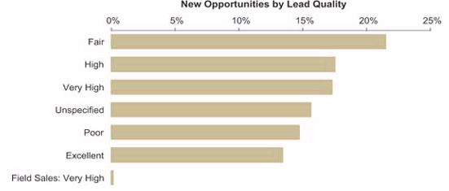
Choosing Inappropriate Display Media
Using a graph when a table of numbers would work better, and vice versa, is a frequent mistake.
The horizontal bar graph does a much better job of displaying part-to-whole data than the pie charts.

Slide 21
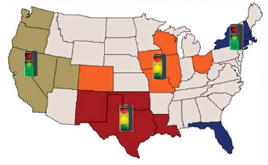
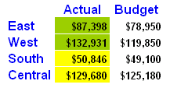
Choosing Inappropriate Display Media
This display uselessly encodes quantitative values on a map of the United States.
This table provides a more appropriate display of the regional revenue data.

Slide 22
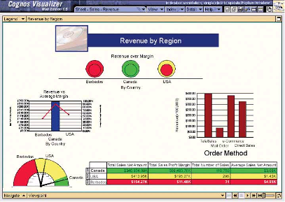
Introducing Meaningless Variety
This dashboard exhibits an unnecessary variety of display media.
Variety might be the spice of life, but you should always select the means of display that works best, even if that results in a dashboard that is filled with nothing but multiple instances of the same type of graph.

Slide 23
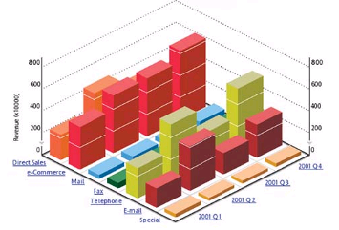
Using Poorly Designed Display Media
This 3-D bar graph illustrates the problem of occlusion.

Slide 24
Three basic types of Charts and where to use them?
1. Bar
2. Line
3. Pie

Slide 25
When to use bar charts: Comparing data across categories
Bar charts are one of the most common ways to visualize data.
It’s quick to compare information, revealing highs and lows at a glance.
Bar charts are especially effective when you have numerical data that splits nicely into different categories so you can quickly see trends within your data
Examples: Volume of shirts in different sizes, website traffic by origination site, percent of spending by department

Slide 26
When to use line charts: Viewing trends in data over time
Line charts are right up there with bars and pies as one of the most frequently used chart types.
Line charts connect individual numeric data points.
The result is a simple, straightforward way to visualize a sequence of values.
Their primary use is to display trends over a period of time.
Examples: Volume of shirts in different sizes, website traffic by origination site, percent of spending by department

Slide 27
When to use Pie charts: Showing Proportions
Pie charts should be used to show relative proportions – or percentages – of information. That’s it.
Despite this narrow recommendation for when to use pies, they are made with abandon. As a result, they are the most commonly misused chart type.
If you are trying to compare data, leave it to bars or stacked bars.
Don’t ask your viewer to translate pie wedges into relevant data or compare one pie to another. Key points from your data will be missed and the viewer has to work too hard.
Limit pie wedges to six
Examples: percentage of budget spent on different departments, response categories from a survey, breakdown of how Americans spend their leisure time

Slide 28

“Simplicity is the ultimate sophistication.” Leonardo da Vinci

Slide 29
Project Assignment #5 (100 Points)
Assignment 5 : Build a Real and Interactive Dashboard
Use one of the following resources:
Domo.com
Tableau.com
http://www.lynda.com/Access-tutorials/Creating-Interactive-Dashboards-Excel-2013/374773-2.html
Others
Dashboard will be demoed on 04/25/2016 in the class. Each team will get 5 Minutes to present
Only ONE Demo on by each team.

Slide 30
Assignment #4 Groups and Coordinators
Group A: American Eagle
Group D: US Steel
Group G: PNC Bank
BOGGS | JARED
BOZIC | DEREK
MAMMAY | ALEX
MCSTAY | EVAN
SCHEFFLER | GARRETT
LAKE | GRIFFEN
MARCUCCI | NICO
MCLAUGHLIN | JUSTIN
PEMBERTON-ZIKELI | DANIEL
SCHULTZ | ROBERT
BISTA | YAM
BOLES | JOHN
GRAYSON | DANIEL
SUBEDI | TEJENDRA
TIMSINA | DIWAS
TINSLEY | NIYIMAH
Group B: CONSOL Energy
Group E: Dicks Sporting
BINTRIM | JORDAN
CLARKSON | ADAM
GOODBREAD | NICHOLAS
HOUGHTON | KEVIN
GUTTIKONDA | HARSHA
LACEY | STONE
MANGANARO | BLAZE
SRIRAMOJU | SUMANTH
The names in red are of group coordinators for assignment #4
Group C: Heinz
Group F: Westinghouse Electric
GAUTAM | UMA
HAMILTON | NIKLAUS
KOZAK | DAVID
TAPIA | SAMUEL
BHAGAT | PARTH
O'BRYON | PATRICK
PATEL | SPARSH
SALEEM | SYED
WITHERS | NATHAN

Slide 31
How to prepare for Mid Term Quiz
Review the content of all the slides from classroom lectures
Watch the Videos from the links on the lecture slides
Watch following Homework Videos
On Lynda.com
The Basics of Data for Analytics with Robin Hunt (35 Minutes)
On Angel under Lessons in ‘Video at Penn State’ folder
Triumph of the Nerds Part 1 (50 Minutes)
Triumph of the Nerds Part 2 (50 Minutes)
Triumph of the Nerds Part 3 (50 Minutes)
Nerds 2.0.1: Networking the Nerds (58 Minutes)
https://www.youtube.com/watch?v=y2HEXBsypMo&list=PLKEJQbGjxKLi1PINXKjIyNWJJzbRb58B-&index=8
How data will transform business (14 Mins)
https://www.youtube.com/watch?v=EHTmxmuhZ10
Harnessing Digital Data for Business Insight (3 Minutes)
https://www.youtube.com/watch?v=XYwiDJ7UWHo&index=1&list=PLKEJQbGjxKLi1PINXKjIyNWJJzbRb58B-
About Quiz
Objective/Multiple Choice/ True-False
Around 50 Questions in 100 Minutes
Will be Open from 6PM – 9PM (Monday March 21st 2016)

